Slide 1

Agenda:
1- Fast Power
2- Revision on GCD
3- Extended GCD
4- Revision on MOD
5- Modular Inverse

Slide 2
Let’s Start!

Slide 3
01
Fast Power:

Slide 4
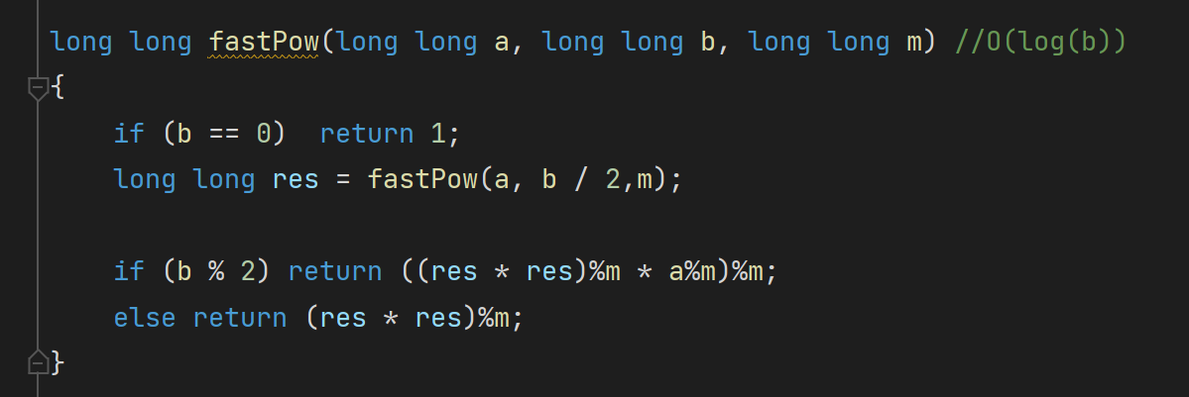

Slide 5
Problem: https://codeforces.com/contest/844/problem/B Solution: Submission #249377851 - Codeforces

Slide 6
02
Revision on GCD:

Slide 7
Euclid's algorithm

Slide 8
03
Extended GCD:

Slide 9
Extended algorithm utilizes computes the following
a and b are the input, x and y are the output

Slide 10
GCD(A, B) | A % B | ⌊A / B⌋ | A % B = A - BQ = A + B(-Q)
(1180, 482) | 216 | 2 | 216 = 1180 + 482 * (-2)
(482, 216) | 50 | 2 | 50 = 482 + 216 (-2)
(216, 50) | 16 | 4 | 16 = 216 + 50 (-4)
(50, 16) | 2 | 3 | 2 = 50 + 16 (-3)
(16, 2) | 0 | 8 | 0 = 16 + 2 (-8)
(2, 0) | gcd(A, B) = 2

Slide 11
GCD(A, B) | A % B = A + B(-Q) | Replace A%B with its equation
(1180, 482) | 216 = 1180 + 482 * (-2) | 2 = 482 (13)+ [1180 + 482 * (-2)] (-29) = 1180 (-29) + 482 * (71)
(482, 216) | 50 = 482 + 216 (-2) | 2 = 216 (-3) + [482 + 216 (-2)] (13) = 482 (13)+ 216 (-29)
(216, 50) | 16 = 216 + 50 (-4) | 2 = 50 + [216 + 50 (-4)] (-3) = 216 (-3) + 50 (13)
(50, 16) | 2 = 50 + 16 (-3) | 2 = 50 + 16 (-3) => Replace 16 with its equation
(16, 2) | 0 = 16 + 2 (-8)
(2, 0) | gcd(A, B) = 2

Slide 12
GCD(A, B) | ⌊A / B⌋ | gcd(a, b) = a * x + b * y | x = prev_y | y = prev_x - q * x
(1180, 482) | 2 | 2 = 1180 (-29) + 482 * (71) | -29 | 13 - 2 * (-29) = 71
(482, 216) | 2 | 2 = 482 (13)+ 216 (-29) | 13 | -3 - 2 * 13 = -29
(216, 50) | 4 | 2 = 216 (-3) + 50 (13) | -3 | 1 - 4 * (-3) = 13
(50, 16) | 3 | 2 = 50 + 16 (-3) | 1 | 0 - 3 * 1 = -3
(16, 2) | 8 | 2 = 0 * 16 + 1 * 2 | 0 | 1
(2, 0) |  | 2 = 1 * 2 + 0 * 0 | 1 | 0 (base case)

Slide 13
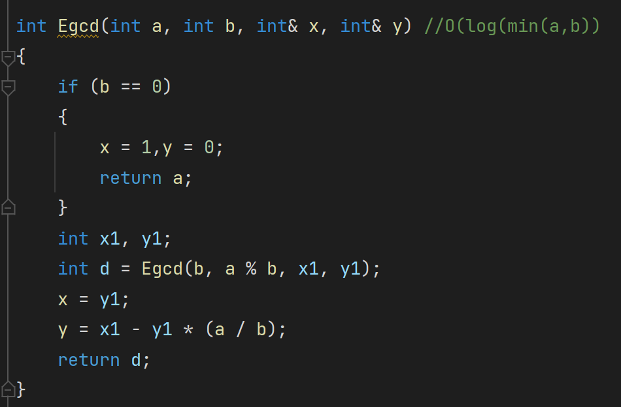

Slide 14
Problem: https://codeforces.com/problemset/problem/7/C Solution: Submission #249382116 - Codeforces

Slide 15
04
Revision on MOD and inverses:

Slide 16
Mod distributed smoothly over +, -, *
(a + b * c) % n = (a%n + (b%n * c%n)%n) % n
Multiplicative inverse
Multiplicative inverse of a number x is 1/x or x⁻¹
For any two numbesr x * y = 1, that means that y = x⁻¹ and x = y⁻¹

Slide 17
05
Modular inverse:

Slide 18
ax ≡ 1 (% m)
This means ax % m = 1 % m
x is multiplicative inverse of a for % m
(ax-1) % m = 0,
ax-1 = qm
ax + m(-q) = 1
This is similar to: ax + my = gcd(a, m) = 1 (note that it is only solvable when gcd = 1)
And now we solve with Egcd as a=a and b=m

Slide 19
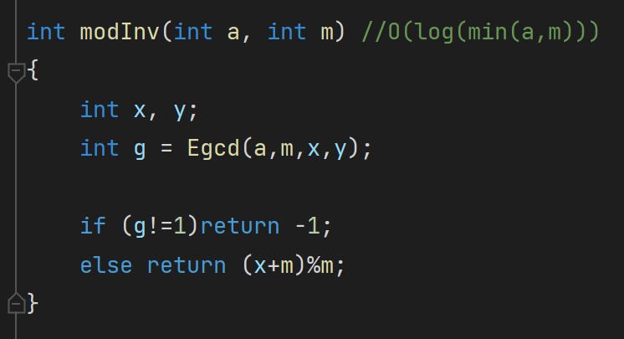

Slide 20
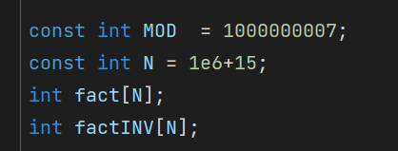
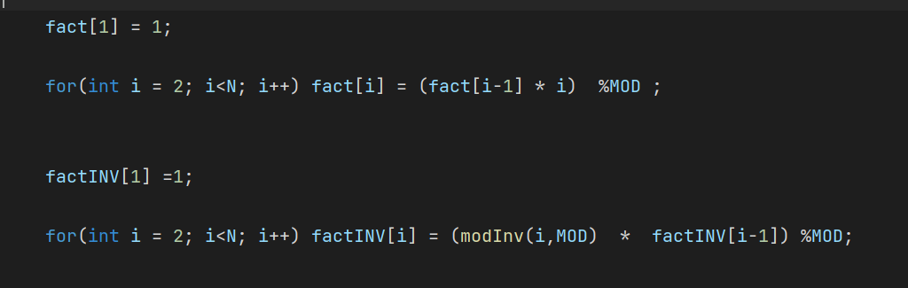

Slide 21
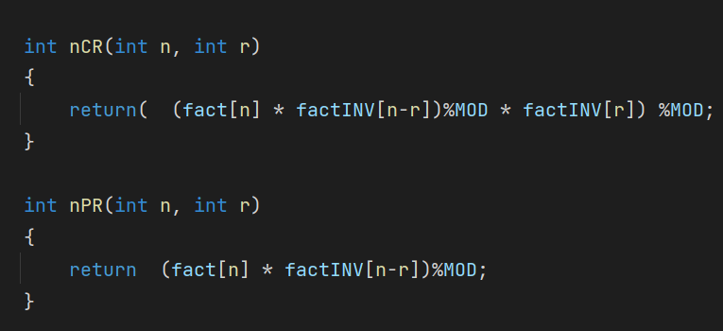

Slide 22
Problem: https://codeforces.com/problemset/problem/1475/E Solution: Submission #249385364 - Codeforces

